Slide 1
Lur Lab Shock Box Circuit
12 V power
supply
LS-241
DB-25 connector
+5 V
Arduino DUE
2
19
20
18
9
25
USB
27
4
16
8
29
6
14
7
31
8
12
6
330
+5 V
33
11
9
5
+
+
35
13
7
4
LED emitter
MOSFET Relay
C
40 shock indicator
37
15
5
3
-
-
39
17
3
2
1
10
330
+5 V
1 Trigger
+
+
+5 V
14 Test In
LED emitter
MOSFET Relay
C
42 tone indicator
-
-
47
Level Converter
BOB-12009
DAC0
SCL
SDA
45
21
20
10 k
+3.3 V
+12 V
SCL
SDA
Vi2c
Audio Amp MAX 9744
Left Speaker
680 pF
Right Speaker

Slide 2
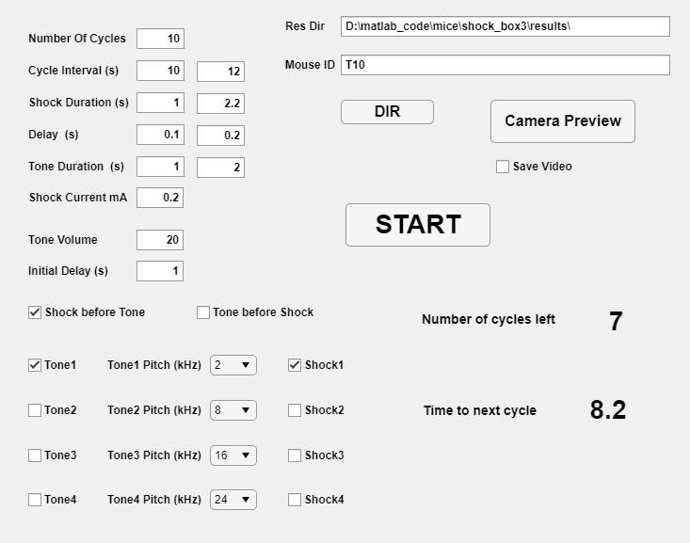
Lur Lab Shock Box GUI
Res Dir
Mouse ID
Camera Preview
Save Video
DIR
START
Displays the result directory
Input the mouse id here
Turn on the camera and preview
Save the video file of the session in the result directory
Select the result directory
Start the session
Total number of shock cycles in the session
Time from the start of a cycle the start of the next cycle
Duration of each shock
Delay from tone to shock or shock to tone for each cycle
Duration of each tone
The amount of shock current
The audio volume for tones
At the start the system waits this amount before proceeding
When selected each cycle is started with a shock followed by a tone
When selected each cycle is started with a tone followed by a shock
Number Of Cycles
Cycle Interval
Shock Duration
Delay
Tone Duration
Shock Current
Tone Volume
Initial Delay
Shock before Tone
Tone before Shock
Each cycle consists of a tone followed or preceded by an optional shock , i.e. a cycle can contain a tone only, but a cycle with a shock is always accompanied with a tone either before or after.
There are 4 possible tones available with an optional shock associated with it.
If more than one tone is selected the tones and the corresponding shocks are played in random order the same number of times (the total number of cycles is adjusted accordingly).
Tone 1 2 3 4
Tone 1 2 3 4 Pitch
Shock 1 2 3 4
Select the tones used
Select the frequencies for the tones used
Select whether a shock is used with the tone

